Slide 1
segmentation
Swagato Chatterjee
(+91)9343931795
swagato1987@gmail.com

Slide 2
Broad Business Questions to be Answered
Mass
High productivity, low profitability
Target group
High profitability and productivity
Avoid
Niche
High profitability but low productivity
Low profitability and productivity
Telecom sector:
Which customers from my customer base creates most revenue and profits?
Retail chain:
Which of the different tier II cities of India should a multinational wholesale retail chain target for entry?
E-commerce:
Whom should I target for my online ad campaign and how?
Retail shop:
Whom should I give the sales promotional offer in my fashion retail shop?
Healthcare:
How should I price the different maternity packages for different customers?

Slide 3
Why segmentation?
It is difficult to serve every market and every customer
Resource constraint, expertise constraint
It is also not profitable to cater to less profitable and less productive segments
It is also important to identify beforehand which segments can lead to losses

Slide 4
Difference between profiling and segmentation
Segmentation is creating groups which are of similar characteristics
Profiling is finding the identifiable characteristics of segments
Segmentation is done on behavioral and value outcomes
Profiling is done based on demographics and psychographics
Profiling is useful only after meaningful segments have been developed

Slide 5
Steps of customer segmentation
Data Collection
Choosing segmentation method
Profiling the segments
Choosing the best possible segmentation scheme
Demographics
Psychographics
Behavior
Value Responses
Targeting the segment
Based on behavior and value responses
Based on demographics and psychographics
Promotional plans
CRM
Loyalty programs
Communication plans
Sales plans
Based on nature of data

Slide 6
Variables used for customer segmentation
Choice of variables is an art
It is advisable to include product specific unobservable variables in clustering
Variables should be simple and non-redundant
The correlation between the variables should be low
The sample size should be at least 2^{m} where m=number of clustering variables
What variables should you choose to cluster your target consumers based on brand communication effectiveness?

Slide 7
Different methods of customer segmentation
Hierarchical clustering
Ward’s Method
K-mean
Model based

Slide 8
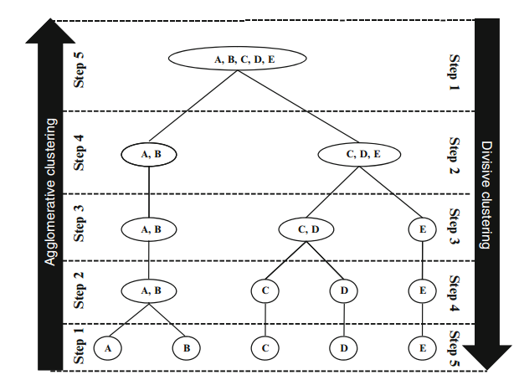
Hierarchical clustering

Slide 9
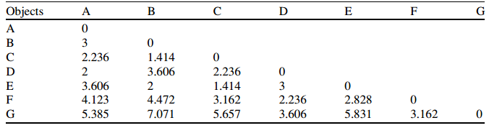
Hierarchical clustering
Single linkage
Complete linkage
Average linkage
Centroid linkage
Customers | Brand awareness | Price sensitivity
A | 3 | 7
B | 6 | 7
C | 5 | 6
D | 3 | 5
E | 6 | 5
F | 4 | 3
G | 1 | 2

Slide 10
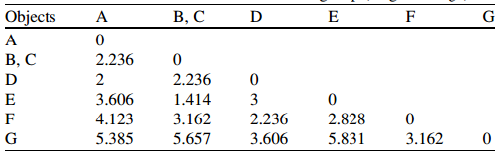
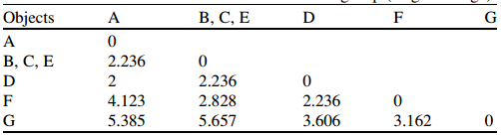
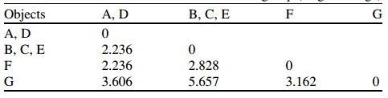



Slide 11
Clusters | Dist
6 | 1.414
5 | 1.414
4 | 2
3 | 2.236
2 | 2.236
Please do the exercise using complete linkage algorithm.

Slide 12



Ward’s method
Agglomerative clustering
Does not consider distance matrix
Most applicable for quantitative variables
Gives almost equal sized clusters if there is no outliers

Slide 13
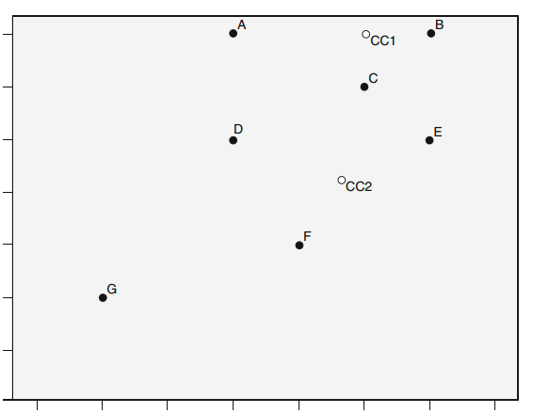
K-Mean
With in cluster variation is minimized

Slide 14
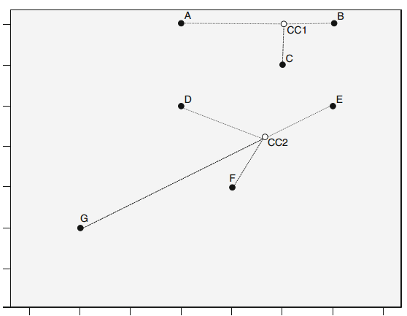
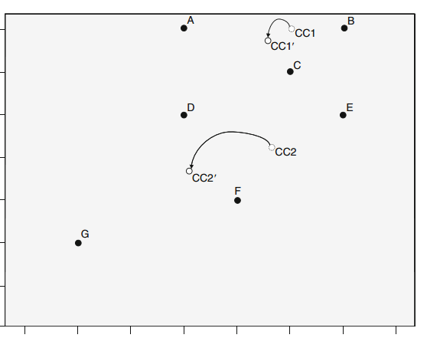
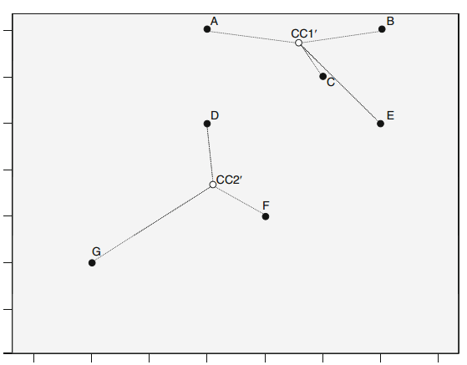

Slide 15
Model based approach
More complex and sophisticated method
Assumption is the data is coming from a multivariate normal distribution
This distribution is a combination of various models or distributions, with various weights associated with it. This model and corresponding weights implies the segments.
The actual calculations are out of scope of the lecture.

Slide 16
Comparison between the methods
Hierarchical methods are best used for ratio data. Ward’s method is best applicable for quantitative data. But k-mean and model based approach can be applied in any type of data.
Model based approach is the best way, but k-mean is most used due to simplicity and ability to handle large data sets.

Slide 17

Finding the best possible segmentation scheme
Scree plot
Variance explained

Slide 18
Judging the segmentation
Stability
Reliability
Validity

Slide 19
Define the segments
Segment wise mean of the variables used
Attach the demographic and psychographic variables for profiling
Find meaningful names and characteristics of the segments
Substantial, Accessible, Differentiable, Actionable, Stable, Parsimonious, Familiar, Relevant, Compactness and Compatibility

Slide 20
Targeting the segments
The focused the target is the better
Large, accessible and actionable segments are best choices
Case study

